Slide 1
Resource Allocation Optimization in Healthcare Enhancing Staffing Efficiency And Reducing Operational Costs
Akshay Venkatesh
Shagun
Anugrah Suresh Kumar Nair
Astha Gungun Patel

Slide 2
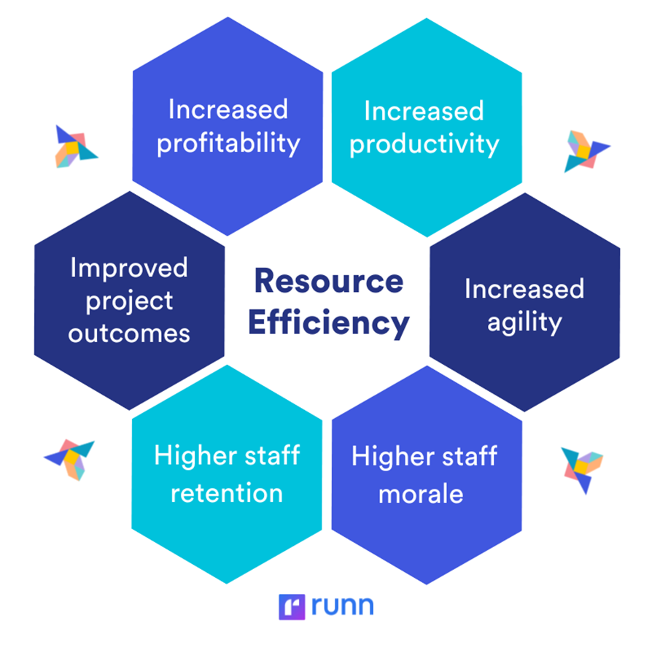
The Importance Of Efficient Resource Management In Healthcare:
Efficient resource management in healthcare is crucial for ensuring optimal patient care while minimizing waste and reducing costs. It helps healthcare systems deliver timely, high-quality services, especially in resource-limited settings or during emergencies.
Additionally, proper management ensures the availability of essential supplies, medications, and equipment, reducing the risk of shortages. It fosters better coordination across departments, leading to improved patient outcomes and satisfaction.

Slide 3
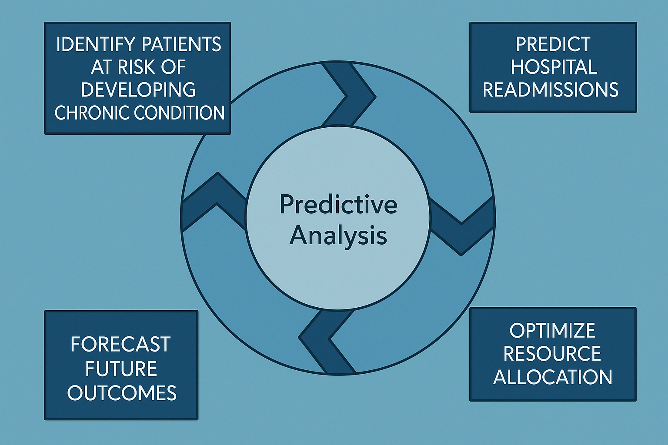
Leveraging Predictive Analytics For Smarter Hospital Resource Management

Slide 4

Smart Staff
Smart Staff is staffing optimization tool designed for healthcare facilities to predict high-demand periods, visualize doctor utilization, and provide data-backed staffing recommendations.
It helps administrators make informed decisions in real time, ultimately improving patient care efficiency and reducing operational costs.

Slide 5
Primary Goals
Predict High-Demand Periods
Uses historical patient data, seasonal trends, and external factors (e.g., flu season, holidays) to forecast peak times.
Helps clinics and hospitals prepare for surges in patient visits.
Visualize Doctor Utilization
Tracks and displays real-time and historical workload metrics for physicians.
Identifies overworked or underutilized staff to improve efficiency.
Provide Staffing Recommendations
AI suggests optimal staffing levels based on demand forecasts.
Reduces wait times, prevents burnout, and maximizes resource efficiency.

Slide 6
Data Ingestion (EHR Integration, Historical Data)
Data Processing ( Cleaning)
Statistical Models (Demand Prediction,Utilization Analysis)
Visualization (Tableau Dashboards, Real-time Monitoring)
Recommendations (Staffing Alerts, Optimization Tips

Slide 7
Data Cleaning and Standardization
Raw Data ( Excel)
Datetime conversion ( Entry Time, Consultation time, Post consultation time )
Derived Metrics(Consultation time Post-consult time)
Feature Engineering ( Extract hours,days months)
Handle incorrect/missing data
Cleaned data set ( Ready for analysis)

Slide 8
Exploratory Data Analysis
EDA is done to derive information regarding patient flow and physician utilization. Visualization tools Tableau are used. Key analyses include:
Consultation Durations: Distribution of consultation lengths to identify outliers and overall trends.
Doctor Utilization: Average consultation time comparison for different types of doctors.
Peak Hours Identification: Patient arrival patterns visualization using time-based heatmaps and line charts.

Slide 9
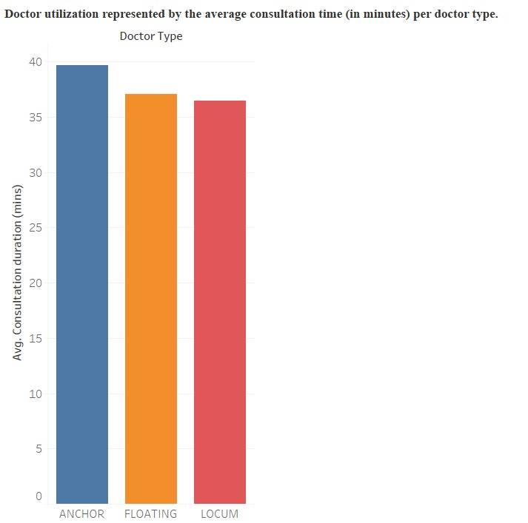
Results and Observations
Avg. Consultation Time by Doctor Type
Anchor doctors have the longest average consultation time.
Floating and Locum doctors spend less time per consultation, with Floating being the lowest.
Implications
Longer consultation times (as with Anchors) may allow for more detailed care but reduce the number of patients seen.
Shorter times (Floating and Locum) may increase patient turnover but risk inadequate care.

Slide 10
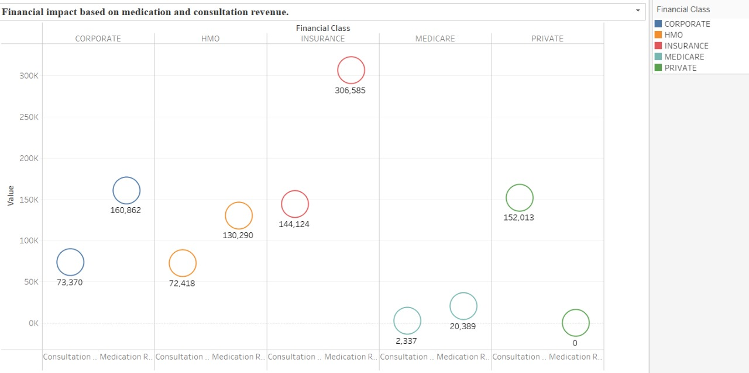

Slide 11
2. Scatter Plot – Financial Impact by Consultation and Medication Revenue Across Financial Classes
Insurance patients generate the highest revenue, particularly in consultation revenue (~307,161).
Private and HMO classes also show moderate consultation and medication revenue.
Medicare shows the lowest revenue figures, especially in medication revenue (~20,309), which is a significant drop compared to others.
Implications:
Financial classes significantly impact revenue generation.
Insurance and Private classes are more profitable.
Medicare patients contribute the least to revenue despite similar resource use.

Slide 12
Time Series Analysis For Demand Prediction
Predicting High-Demand Periods in Hospitals Using Predictive Analytics
01
Data Aggregation:Data is combined into appropriate time intervals, such as hourly, daily, or weekly, to capture relevant trends.
02
Visualization with Time-Series Plots : Seasonal patterns and trends are visualized using time-series plots to identify recurring demand cycles.
03

Slide 13
Time Series Decomposition
The data is decomposed into three main components:
Trend: Long-term movement in the data.
Seasonality: Regular patterns that repeat over a fixed period.
Residuals: Random noise or unexplained variations.

Slide 14
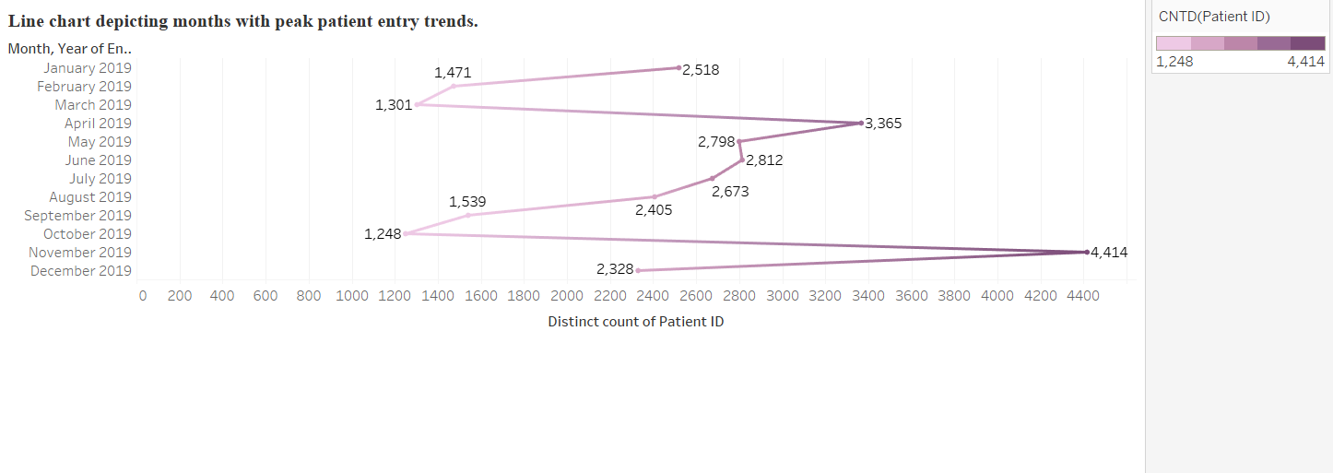
Seasonal Patient Flow Patterns
Peak Periods:
November 2019 saw the highest patient volume (4,414 visits)
Low-Traffic Months:
October 2019 had the lowest volume (1,248 visits)

Slide 15
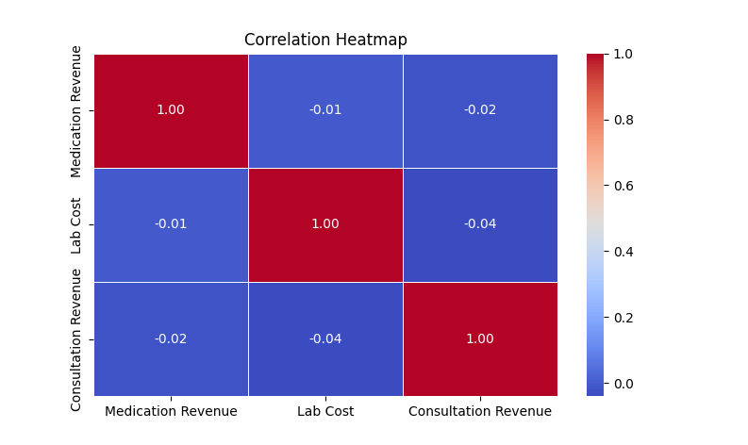
Correlation Heatmap:
Key Insights & Observations:
Weak/Negligible Correlation between Medication Revenue and Lab Cost (near-zero values: -0.01 to -0.02).
Strong Negative Correlation (-0.8) between Consultation Revenue and Medication Revenue, suggesting potential substitution effect (e.g., fewer medications prescribed during consultations).
No Significant Relationships for other variable pairs (most correlations close to zero).

Slide 16
Areas for Improvement:
Investigate Consultation-Medication Trade-off: Analyze why higher consultation revenue correlates with lower medication revenue (e.g., preventive care reducing prescriptions).
Optimize Bundled Services:
Explore pricing/packaging strategies for consultations and medications to maximize combined revenue.
Ignore Spurious Correlations: Focus only on statistically significant relationships (e.g., Consultation-Medication link) for decision-making.

Slide 17
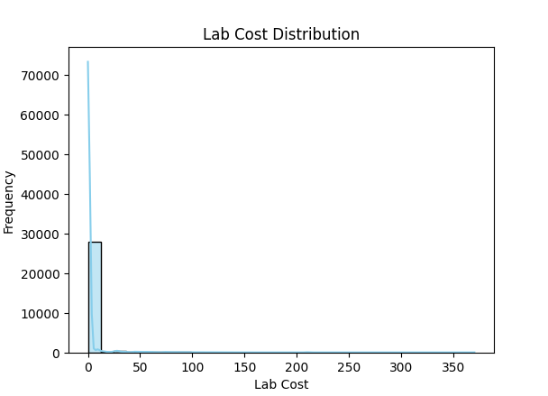
Lab Cost Distribution:
Key Insights & Observations:
Right-Skewed Distribution:
Most lab costs are concentrated at the lower end, indicating that the majority of tests are inexpensive.
Few High-Cost Outliers:
A small number of lab tests have significantly higher costs, which could be specialized or complex procedures.
Low-Cost Dominance:
The high frequency of low-cost tests suggests that standardized, routine lab work makes up most of the testing volume.

Slide 18
Areas for Improvement:
Cost Optimization for Routine Tests – Negotiate bulk pricing or streamline processes for frequently ordered low-cost tests to improve margins.
Review High-Cost Tests – Analyze whether the most expensive tests are necessary, overused, or could be replaced with more cost-effective alternatives.
Demand Forecasting – Adjust inventory and staffing based on the volume of low-cost vs. high-cost tests to improve resource allocation.
Pricing & Billing Strategy – Ensure high-cost tests are properly justified and reimbursed to avoid revenue leakage

Slide 19
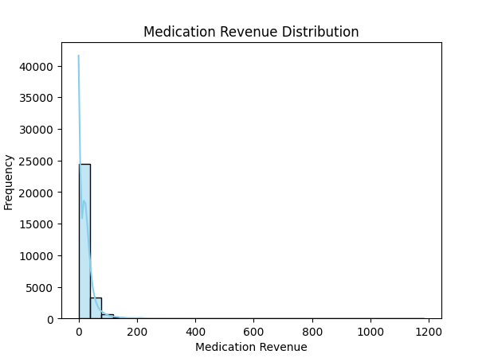
Medication Revenue Distribution:
Key Observations:
The revenue distribution is right-skewed, with most medications generating lower revenues .
Results:
High-revenue medications are rare but critical for overall profitability.
The majority of medications yield minimal revenue, indicating a long-tail distribution.

Slide 20
Areas for Improvement:
Focus on High-Revenue Medications: Prioritize inventory and marketing efforts for medications generating revenues above $1000.
Cost Control for Low-Revenue Items: Review the necessity of stocking low-revenue medications or explore bulk purchasing to reduce costs.
Demand Analysis: Investigate prescribing patterns to optimize the balance between high- and low-revenue medications.
Pricing Strategy: Consider adjusting prices or promotions for underperforming medications to boost revenue.

Slide 21
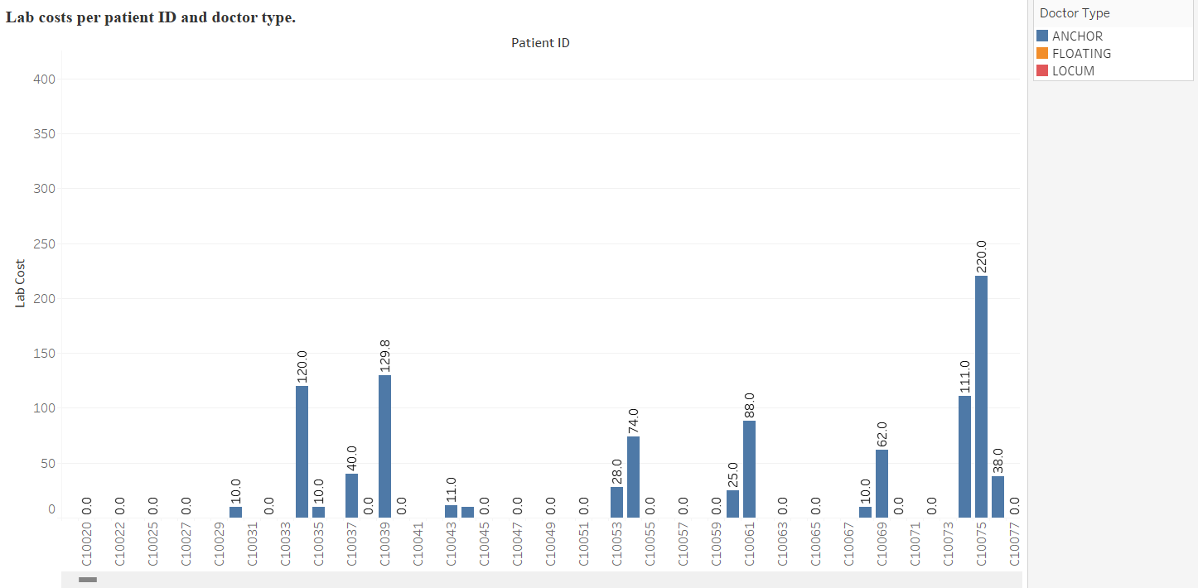
Lab costs per patient ID and doctor type:
Results and observations:
The graph here represents the lab costs charged per patient ID classified by specific doctor type, namely Anchor, Floating, and Locum. Based on the patterns obtained by the chart, it is easy to say that a large number of lab costs are generated by the Anchor doctor type, with the highest lab cost for an individual patient going up to a total of $330. It is also evident that a lot of patients are not charged for lab costs, indicating a lower need for lab diagnosis. The patients reported by the Anchor doctor type generated the highest lab costs revenue, followed by Locum and lastly Floating.

Slide 22
Areas for Improvement:
This visualization also gives you an idea that the Floating and Locum doctors comparatively have a lower patient volume and hence lower lab cost revenue as well. it is important to recognize the factors contributing to the lower patient volume associated with them to further improve the lab cost revenue.

Slide 23
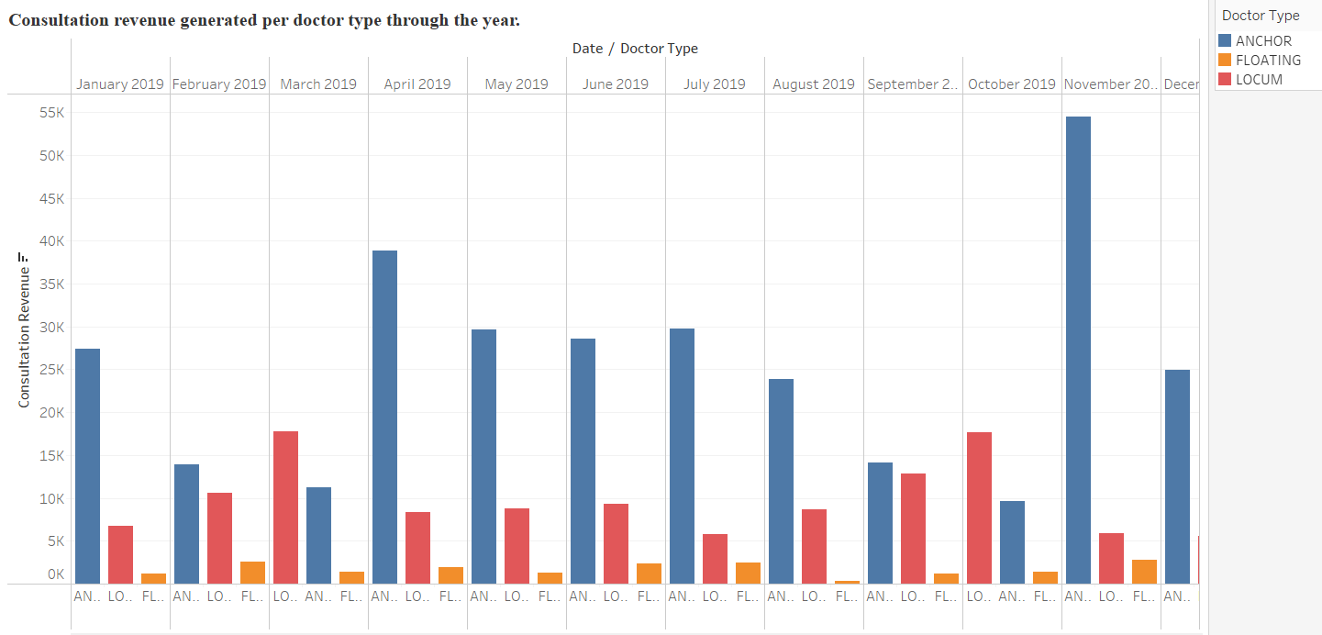

Slide 24
Results and observations:
This bar chart represents the consultation revenue classified by each doctor type, namely, Anchor, Floating, and Locum, throughout the year. Considering the overall performance amongst the three doctor types, Anchor doctors outperformed Floating and Locum doctor types, generating the highest consultation revenue. Anchor doctors generated an annual consultation revenue of $300,000, followed by Locum with a total consultation revenue of around $120,000, and lastly Floating, generating a consultation revenue of around $20,000. Considering the monthly revenue generated by the doctor types, Anchor doctors generated the highest consultation revenue in the month of November 2019, reaching up to a total of $55,000. The peak months for consultation revenue are observed to be November, followed by April and July.
Areas for Improvement:
Based on the observations mentioned, it is important for the hospital to analyze the factors that increase the demand for Anchor doctor types and further implement the same for Floating and Locum doctor types for better results. Looking at the performance of the Floating doctor type, it is required to look for reasons that are contributing to their lower performance, for example, setting up an appointment with the Floating doctor type could be comparatively difficult with a higher wait time that leads to lower patient volume, improving this factor by appropriately utilizing resources and reducing wait times could improve their consultation revenue as well.

Slide 25
ARIMA (Autoregressive Integrated Moving Average) Is A Widely Used Statistical Model For Analyzing And Forecasting Time Series Data. Hospitals Use ARIMA To Anticipate Patient Load, Helping Them Plan Staff Schedules, Bed Availability, And Medical Supplies More Effectively.
The components of ARIMA include the following:
Auto Regression (AR): Past values are used to predict current values.
Integration (I): Differencing of raw observations to make the time series stationary.
Moving Average (MA): Past forecast errors are used to improve predictions.

Slide 26
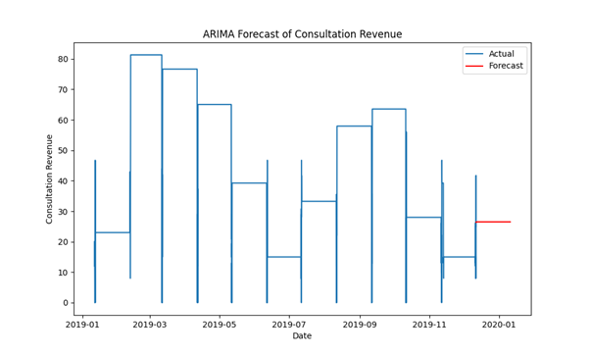

Slide 27
Observation from ARIMA Forecast:
Time-series analysis reveals higher patient volumes during January, February, and March.
This indicates a seasonal pattern in patient flow.
Recommendation:
Increase staffing levels during these peak months to manage higher patient loads efficiently.
Adjust physician schedules, allocate additional support staff, and extend consultation hours if necessary.

Slide 28
Key Results and Observations
1. Actual Revenue Pattern (2019)
Peak Revenue: Consultation revenue peaked around March 2019, reaching above 80 units.
Decline & Fluctuation: After March, there was a steady decline in revenue through May and strong fluctuations from June to November.
Throughs: The lowest revenue was seen around July and November, dropping below 20 units.
2. Forecasted Revenue (End of 2019)
Predicted Value: The forecasted revenue is around 27 units, suggesting a slight increase compared to the low point in November.
No Strong Surge: The model doesn't predict a return to earlier high levels (e.g., March) in the short term.
3. Forecasting Insights
The ARIMA model seems to capture seasonal trends, such as periodic increases and drops.
Despite fluctuations in 2019, the forecast anticipates a stable but low recovery, with no dramatic increase in consultation revenue by the end of the year.

Slide 29
Smart staff Recommendations
High-Demand Months: Increase staffing and consultation capacity during February, March, and April to address the higher projected consultation revenue.
Low-Demand Months: Scale down non-essential operations or shift resources in June, July, November and December.
Next 30-Day Forecast: Maintain baseline levels of staff and watch short-term trends closely.
Implement preventive care or wellness programs in historically low-demand months to improve revenue stability.
Increase visibility and availability of low-utilization but high average consultation revenue physicians.
Prioritize stock monitoring and ordering for drugs with consistently higher revenue.

Slide 30
Expected Outcomes
Reduced patient wait times during peak periods.
Better physician workload balance.
Improved patient satisfaction and overall service quality.

Slide 31
THANK YOU!

Slide 32
REFERENCES:
Akbasli, I. T., Birbilen, A. Z., & Teksam, O. (2025). Artificial intelligence-driven forecasting and shift optimization for pediatric emergency department crowding. JAMIA Open, 8(2). https://doi.org/10.1093/jamiaopen/ooae138
Borhade, R. R. (2024). AI-enhanced predictive analytics for proactive healthcare management: Leveraging machine learning to optimize patient care. Panamerican Mathematical Journal, 34(2), 123–138. https://doi.org/10.52783/pmj.v35.i1s.2096
Choudhury, A., & Urena, E. (2020). Forecasting hourly emergency department arrival using time series analysis. British Journal of Healthcare Management, 26(1), 34–43. https://doi.org/10.12968/bjhc.2019.0067
Erkamp, N. S., van Dalen, D. H., & de Vries, E. (2021). Predicting emergency department visits in a large teaching hospital. International Journal of Emergency Medicine, 14(1). https://doi.org/10.1186/s12245-021-00357-6
Ingole, P., Baviskar, P. R., Ghuge, M. S., Dakhare, B. S., Dongre, Y., & Dubey, P. (2025). Optimizing resource allocation in hospitals using predictive analytics and information systems. Journal of Information Systems Engineering & Management, 10(1s), 400–415. https://doi.org/10.52783/jisem.v10i1s.224

